Slide 1
PyTest Tutorials

Slide 2
Pytest Introduction
Pytest is feature-rich plugin-based ecosystem for testing your python code.
Makes testing experience more productive.
Advantages of Pytest:
Free and Open source
Parallel execution.
Auto-detection of test files and functions.
Feature to skip tests.
Allows to run subset of tests.
Seamless integration with CI/CD pipelines.

Slide 3

Installation
Pytest is a python package which can be installed using pip command from command line
Once installed propertly, you can verify it in site-packages.
pip install pytest

Slide 4
Pytest Test Discovery
Test discovery is crucial aspect of any testing framework.
It involves automatic identification and collection of test files and functions from project directory.
Pytest test discovery rules:
File naming convention:
Pytest recognizes test files based on their names.
A test file can be named using one of these conventions:
It starts with ‘test_’. (e.g test_my_project.py)
It starts with ‘_test.py’ (e.g. my_project_test.py)
2. Test Function Naming Convention:
Inside the test files, Pytest identifies test functions based on their names.
A test function should start with test_ (e.g., def test_my_function()).
3. Custom Selection Through Markers:
Pytest enables user to even customize the test discovery using markers.

Slide 5
Pytest Execution
When in project directory you can use below pytest commands to execute test cases.
pytest -v
Executes all the pytest test cases in the directory.
pytest filename -v
Executes all the pytest test cases in the given file
pytest –k <substring> -v
Executes all the pytest test cases in the given directory whose name consists given substring.
Note:
All above commands can be executed without ‘-v’ as well.
Addition of ‘-v’ with pytest commands gives detailed execution information.

Slide 6
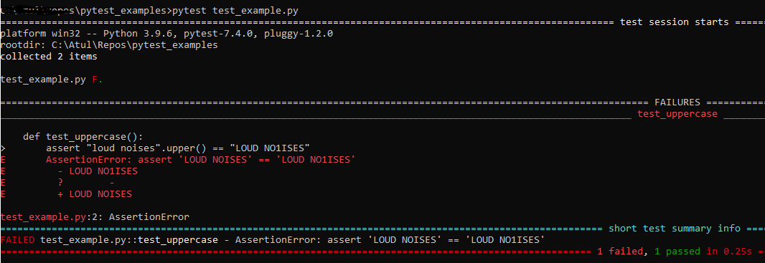
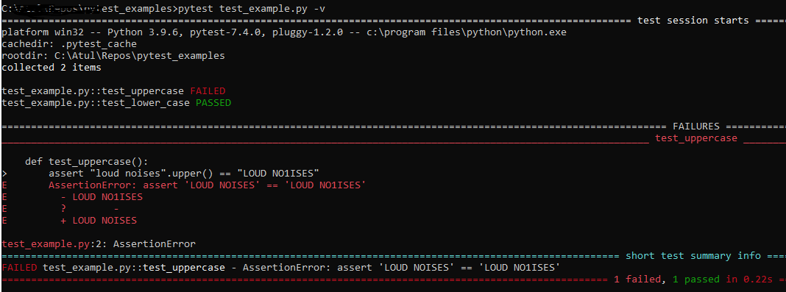
Pytest Execution

Slide 7
Pytest Markers
Pytest allows user to use markers on the test functions.
Inbuilt markers – xfail, skip, parameterize.
User can create customized markers using below syntax:
Command for running the marked test
@pytest.mark.<marker_name>
Pytest –m <marker_name> -v

Slide 8
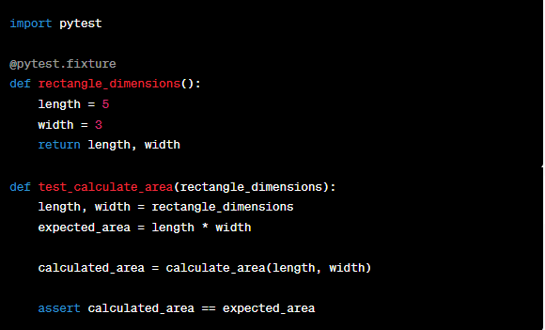
Pytest Fixtures
Fixtures are functions which will run before each test function to which it is applied.
A test function can use fixture name as input parameter.
In this example -
rectange_dimenstion is a fixture.
test_calculate_area is the test function
to which we are supplying this fixuture.
Before each the the test function gets
called, fixture will be executed.

Slide 9
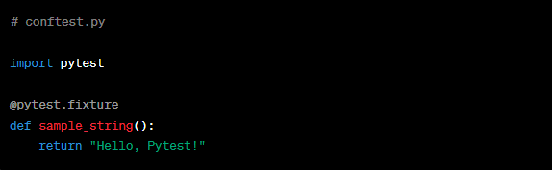
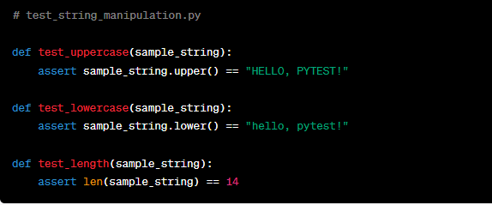
Pytest Fixtures – conftest file
Define fixtures in this conftest.py file to make them accessible across multiple files.

Slide 10
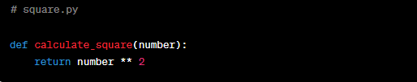
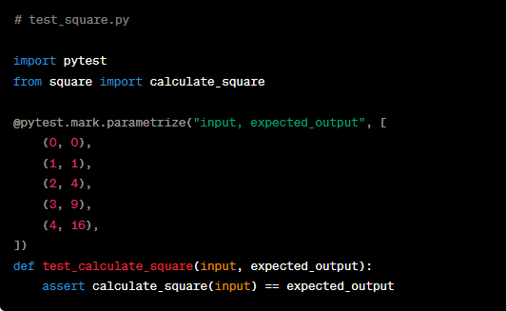
Parameterizing tests
Execute same tests against multiple inputs.
This can be done by using inbuild pytest market
In this example, there are two parameters used –
input,expected_output
test_calculate_square will be executed 5 times in this example.
@pytest-mark.parameterize(“parameters”, [parameter values])

Slide 11
Parallel execution
Pytest by default will execute tests in sequential order.
It can be time consuming for large test suite.
It is always advisable to execute test cases parallelly, which will in turn reduce overall execution time.
To enable parallel execution, pytest-xdist library is to be installed.
After installing this library, below command can be used for parallel execution.
pip install pytest-xdist
pytest –n <count>

Slide 12
Pytest with Selenium
Selenium is library for automating web scenarios.

